Slide 1
Neural Bootstrapper
Jan 4, 2022
Gwangwoo Kim

Slide 2
Contents
Introduction
Preliminaries
Neural Bootstrapper
Empirical Studies
References

Slide 3
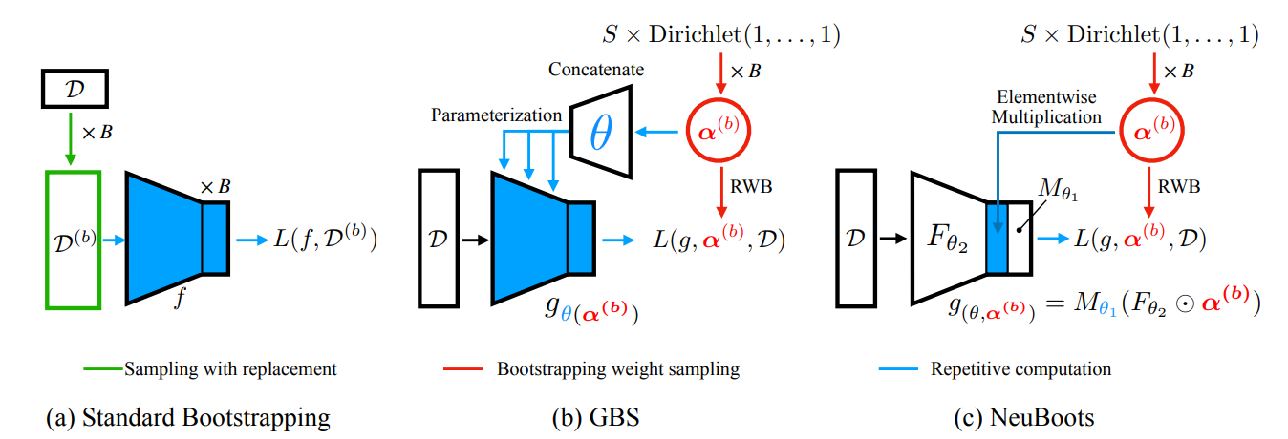
1. Introduction

Slide 4
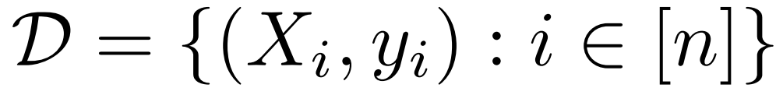
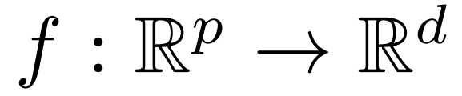
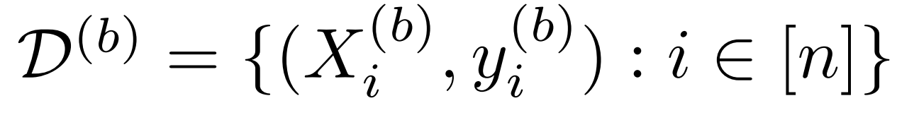
2. Preliminaries
We have a labeled data
and want to find a classifier
For the standard bootstrapping, we sample B sets of bootstrap data
with replacement

Slide 5
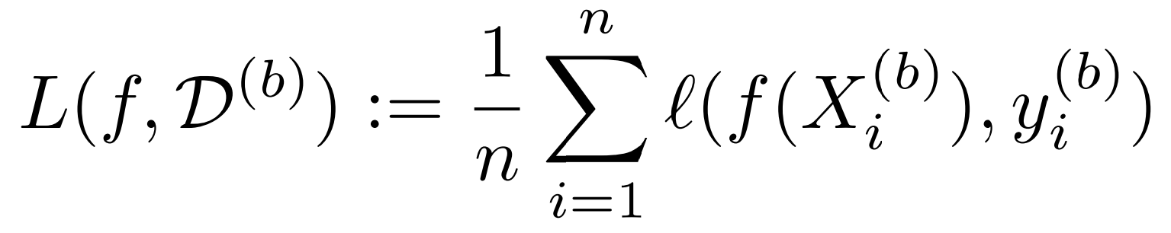
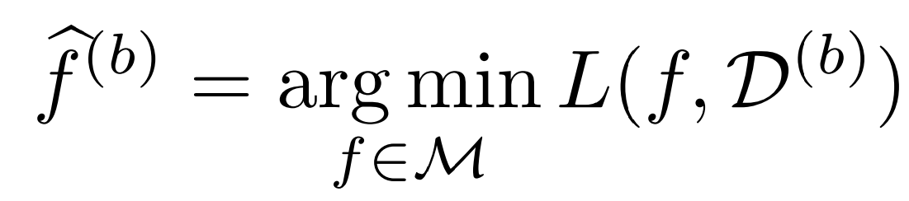
2. Preliminaries
Define a loss functional
and then we minimize the above with respect to

Slide 6
2. Preliminaries
According to In Advances in neural information processing systems

Slide 7
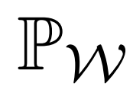
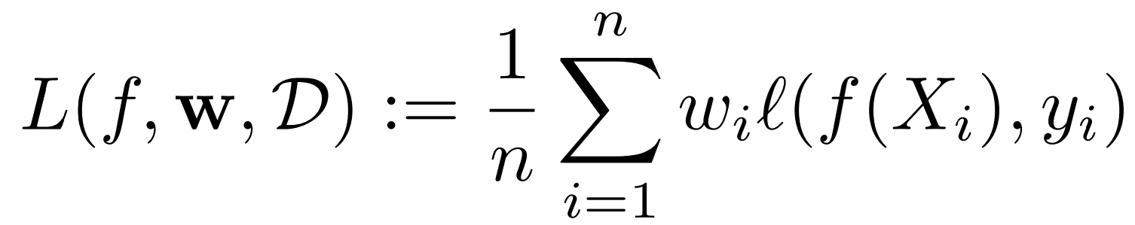
2. Preliminaries
Let and let be a probability distribution on the simplex
In order to resolve the previous problem, we introduce a new loss functional

Slide 8
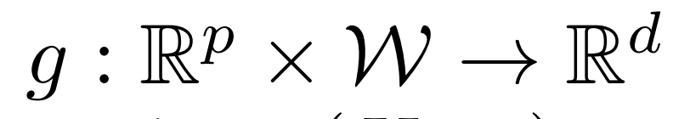
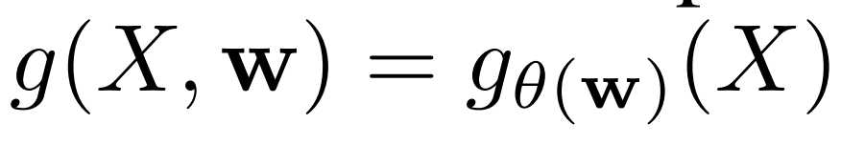
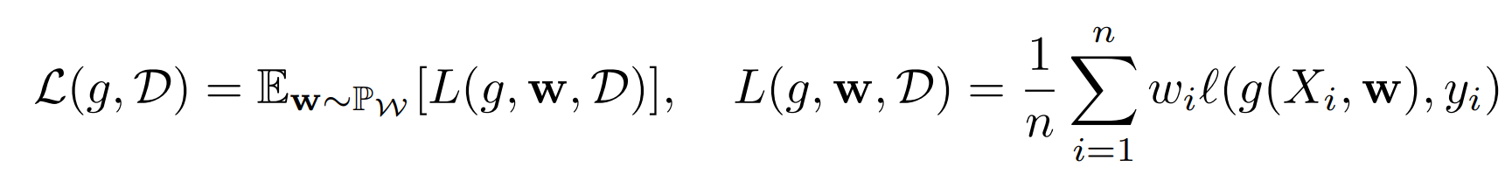
2. Preliminaries
But training multiple networks remains a computational problem, and one has to store the parameters of every network for prediction.
Consider a bootstrap generator defined as
So our loss is transformed into

Slide 9
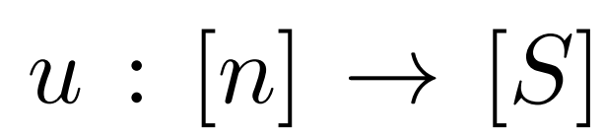
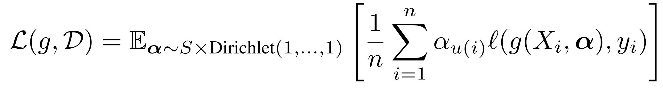
2. Preliminaries
When the number of data is large, the optimization would be hurdled.
Let denotes the assignment function.
So our final loss is

Slide 10
3. Neural Bootstrapper

Slide 11
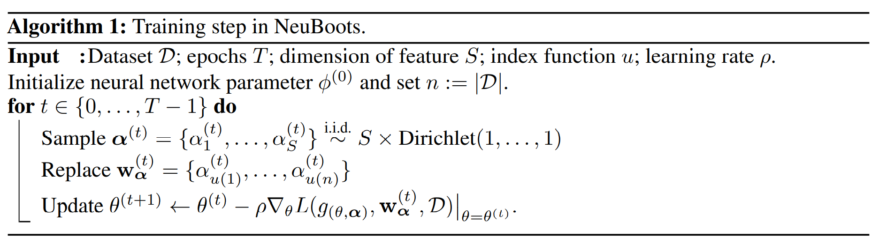
3. Neural Bootstrapper
<Remark> This modification brings a computational benefit, since we can generate bootstrap samples quickly and memory-efficiently by reusing a priori computed tensor without repetitive computation from scratch.

Slide 12
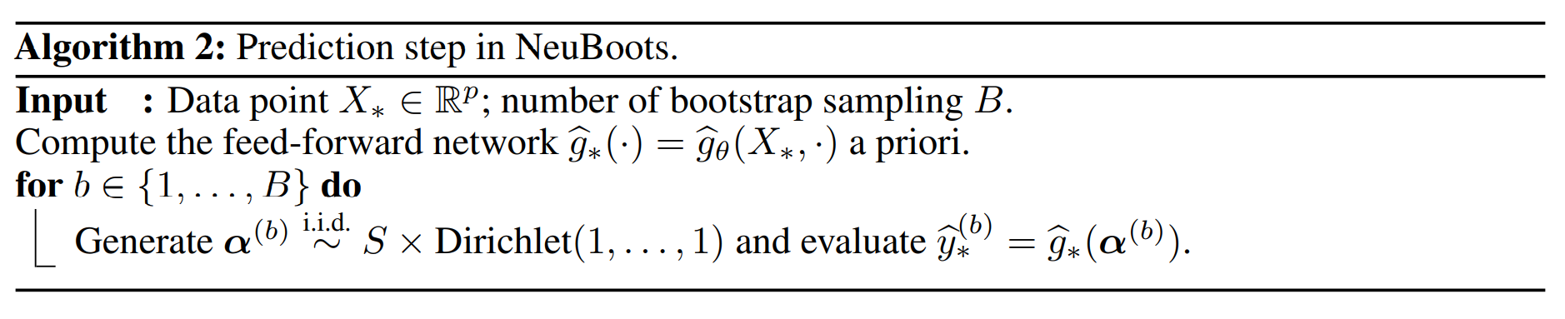
3. Neural Bootstrapper

Slide 13
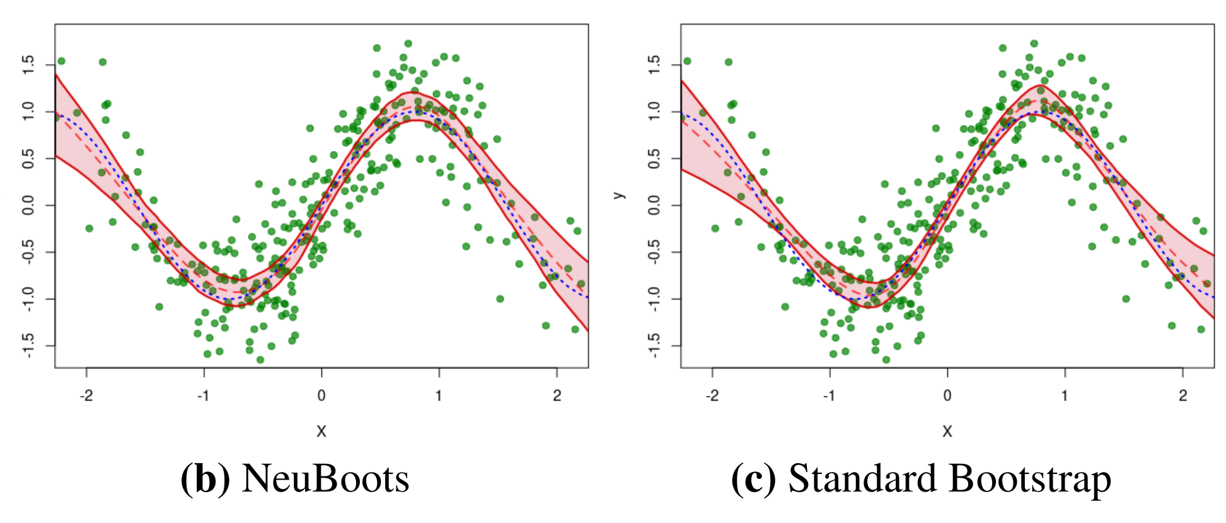
3. Neural Bootstrapper
NeuBoots vs Standard Bootstrap

Slide 14
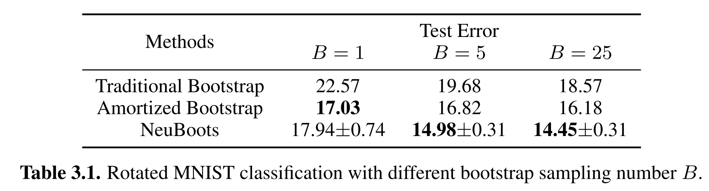
3. Neural Bootstrapper
NeuBoots vs Amortized Bootstrapping

Slide 15
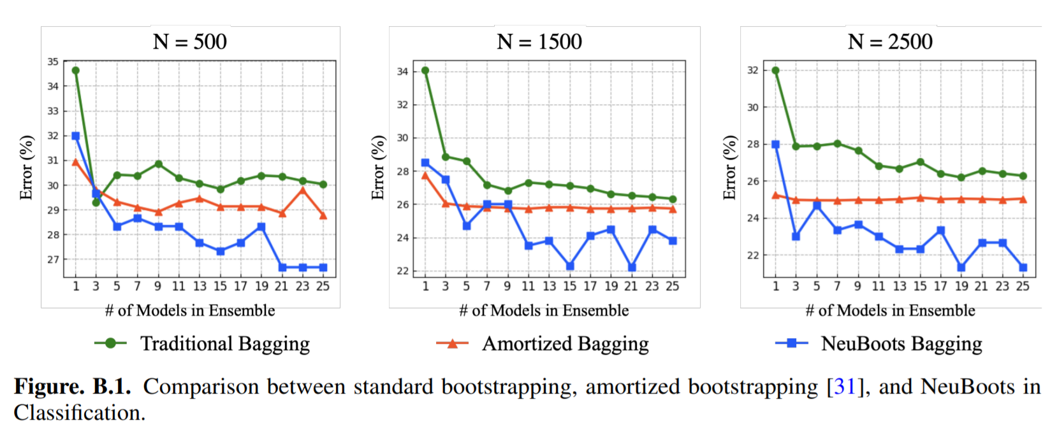
3. Neural Bootstrapper
NeuBoots vs Amortized Bootstrapping

Slide 16
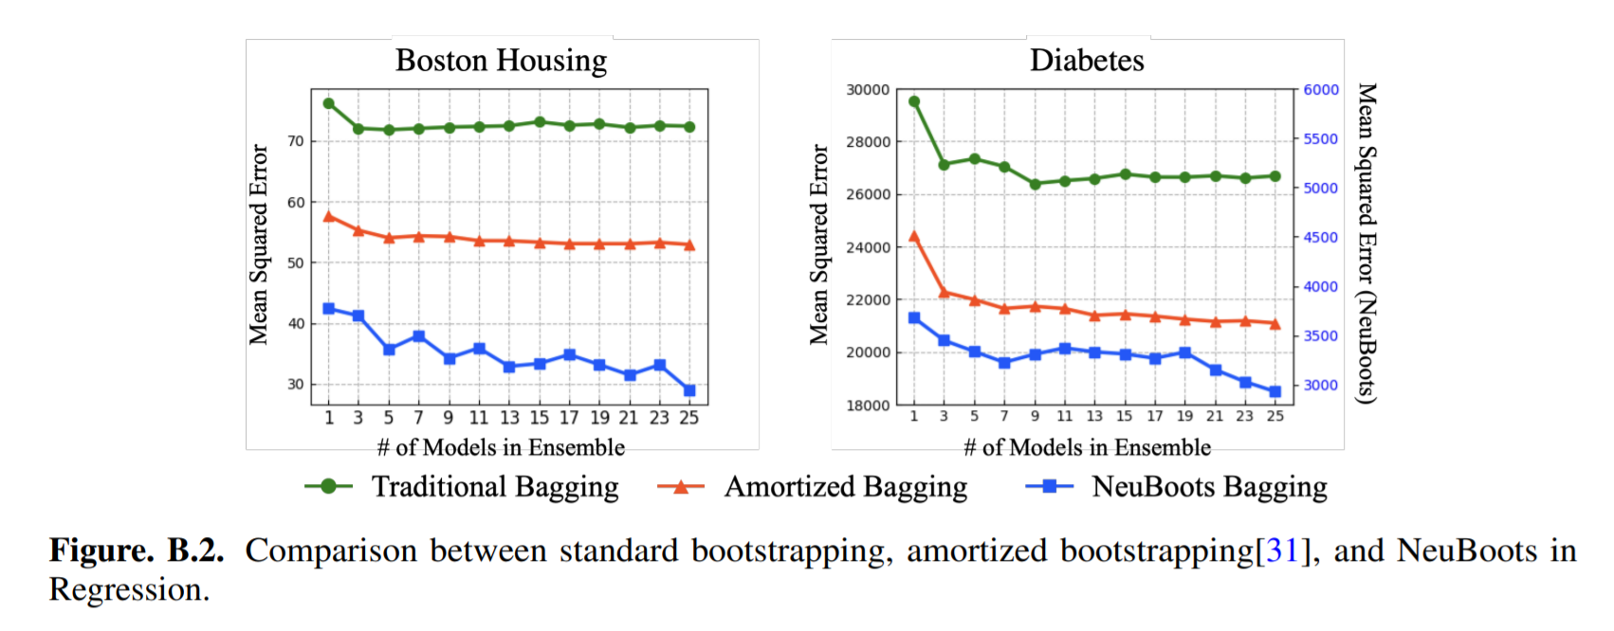
3. Neural Bootstrapper
NeuBoots vs Amortized Bootstrapping

Slide 17
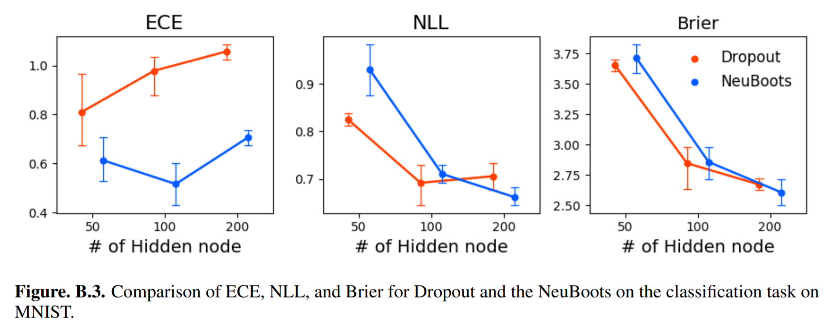
3. Neural Bootstrapper
NeuBoots vs Dropout

Slide 18
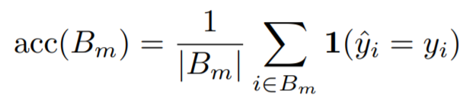
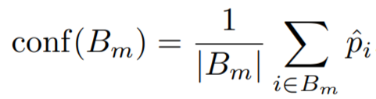
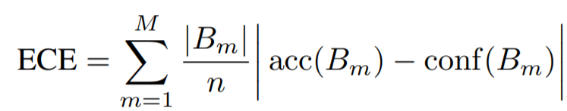
3. Neural Bootstrapper
NeuBoots vs Dropout

Slide 19
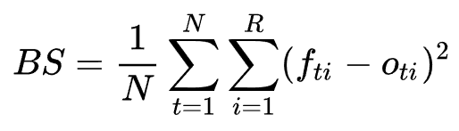
3. Neural Bootstrapper
NeuBoots vs Dropout

Slide 20
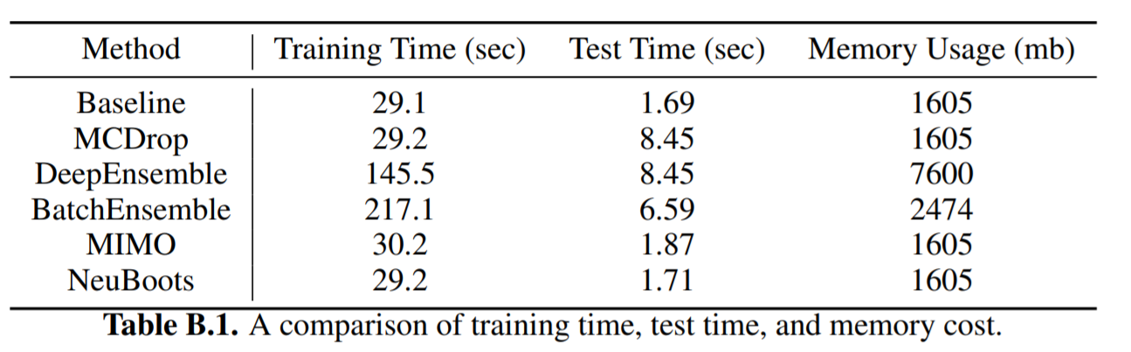
3. Neural Bootstrapper
Computation time and cost

Slide 21
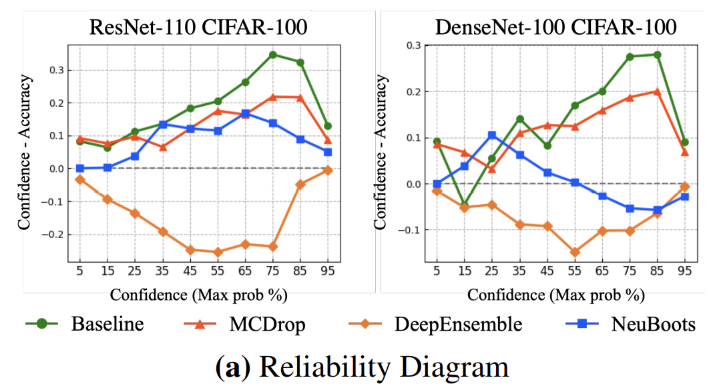
4. Empirical Studies

Slide 22
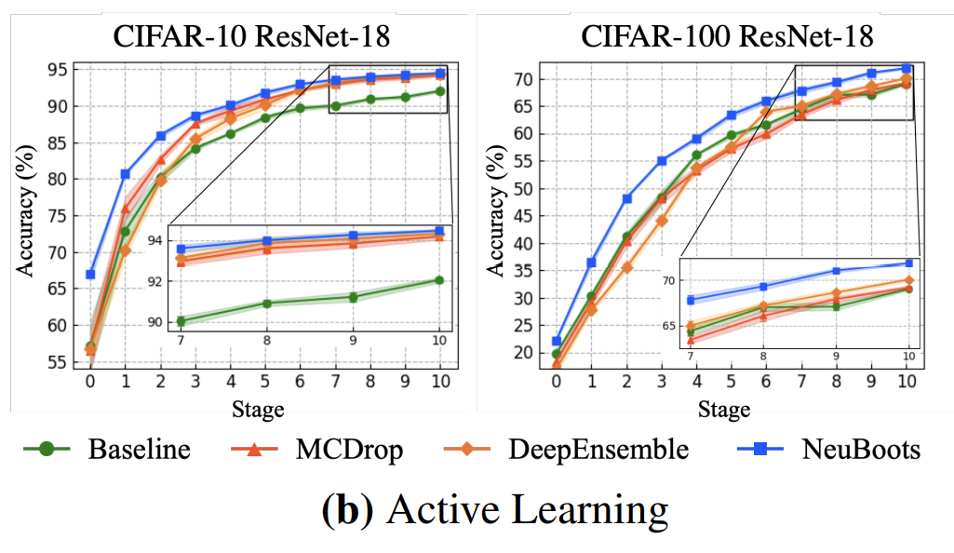
4. Empirical Studies

Slide 23
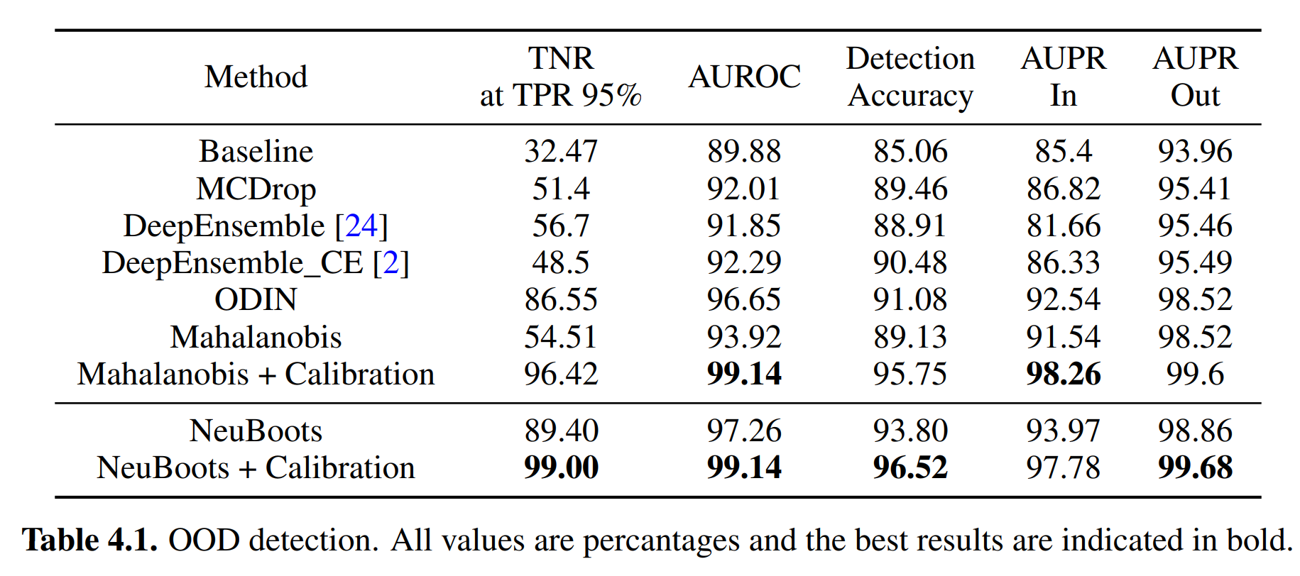
4. Empirical Studies

Slide 24
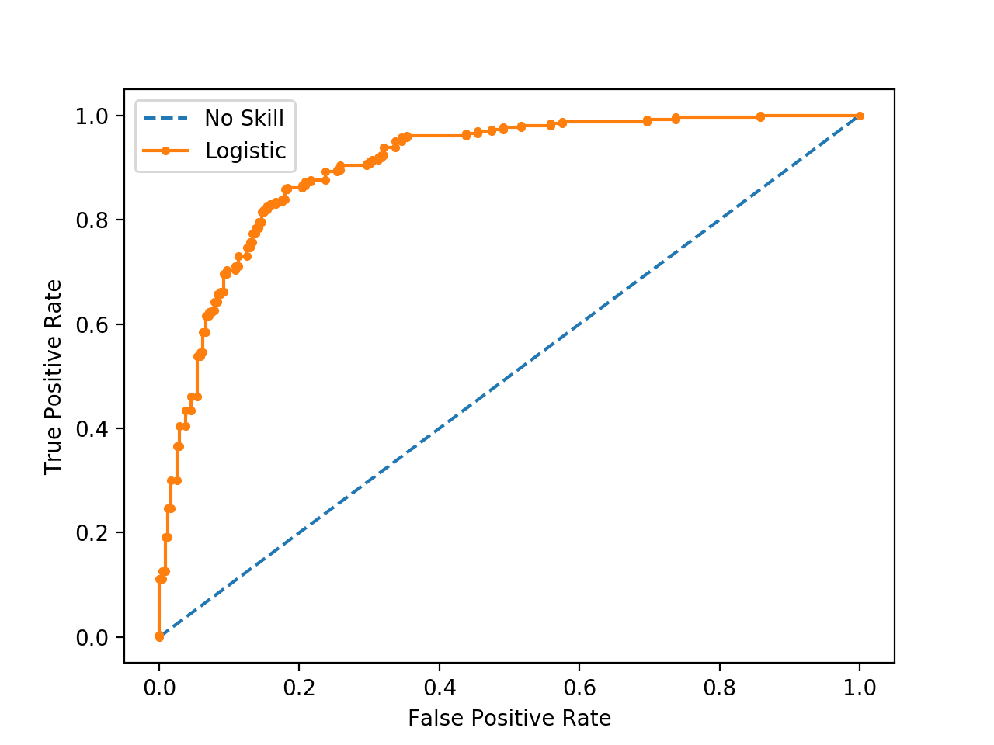
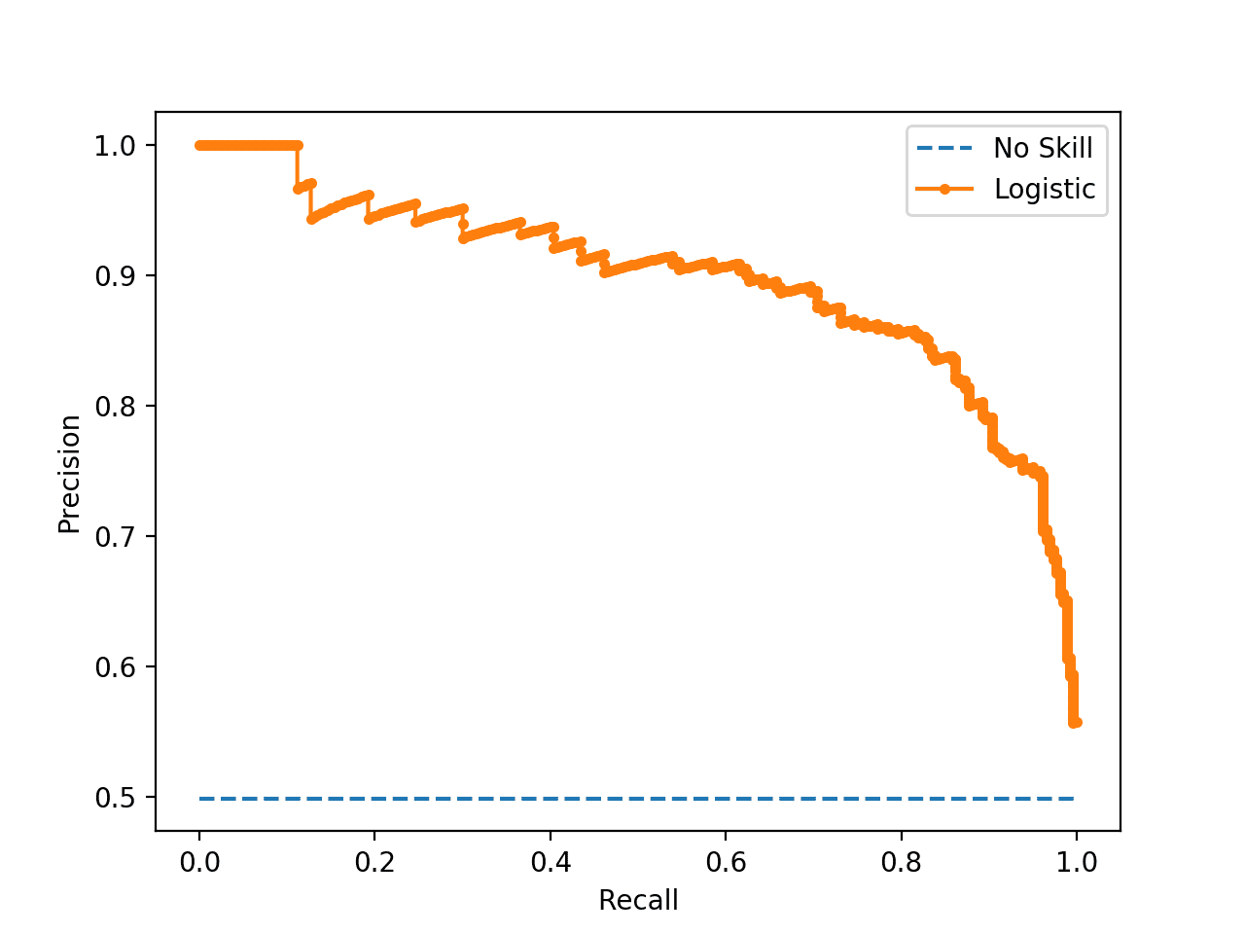
4. Empirical Studies

Slide 25
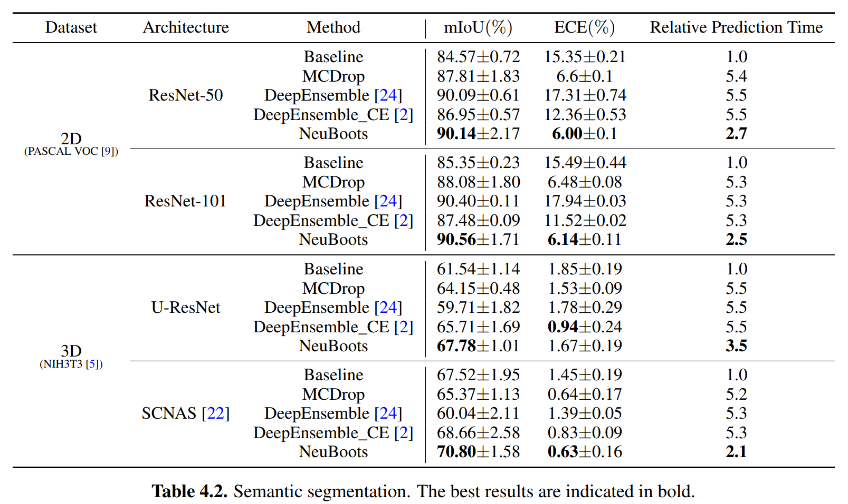
4. Empirical Studies

Slide 26
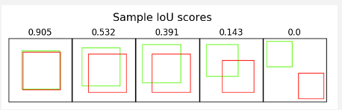
4. Empirical Studies

Slide 27
4. Conclusion
Scalable bootstrapping method, NeuBoots.
Our empirical studies show that NeuBoots attains significant potential in quantifying uncertainty for large-sized applications. (such as biomedical data analysis with high-resolution)
As a future research, one can apply NeuBoots to natural language processing tasks using Transformer.

Slide 28
5. References
[1] Shin, M., Cho, H., & Lim, S. (2020). Neural Bootstrapper. arXiv preprint arXiv:2010.01051.
[2] Lakshminarayanan, B., Pritzel, A., and Blundell, C. (2017). Simple and scalable predictive uncertainty estimation using deep ensembles. In Advances in neural information processing systems, pages 6402–6413.
[3] Guo, C., Pleiss, G., Sun, Y., & Weinberger, K. Q. (2017, July). On calibration of modern neural networks. In International Conference on Machine Learning (pp. 1321-1330). PMLR.
[4] Brier, G. W. (1950). Verification of forecasts expressed in terms of probability. Monthly weather review, 78(1), 1-3.
[5] endrycks, D. and Gimpel, K. (2017). A baseline for detecting misclassified and out-of-distribution examples in neural networks. Proceedings of International Conference on Learning Representations.

